Slide 1

Game Design from Scratch
January 2016
@mcromievusd

Slide 2
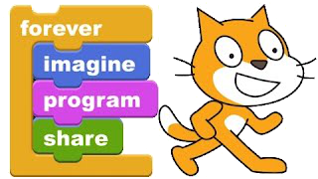
Welcome!
This presentation is meant to be used to teach the basic skills and tools needed to create a simple game in Scratch. I believe it’s appropriate for teachers and students alike.
Here’s my Scratch profile
Here’s a link to the game that this presentation is all about.
Here’s the rationale I prepared for the January inservice day

Slide 3
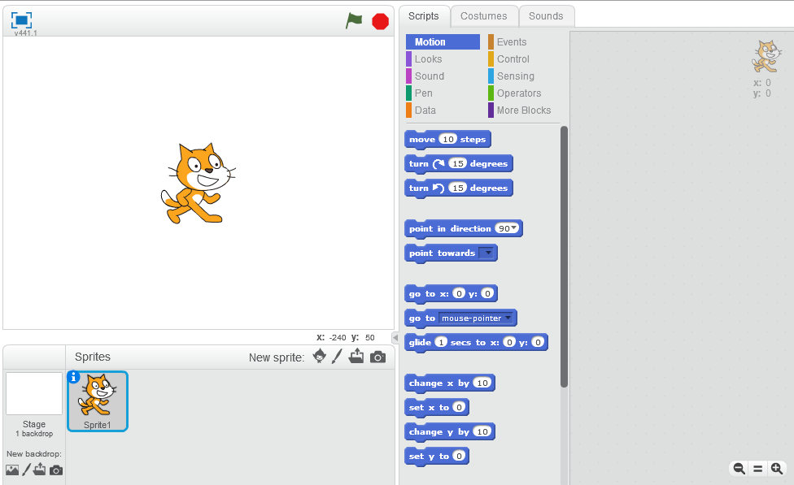
Part 1: The Scratch Interface
Tabs
The Stage
Menus
Scripts Area
We won’t need the cat, right click on him and delete him. I believe his name is Scratchy.
Blocks
Sprites List

Slide 4
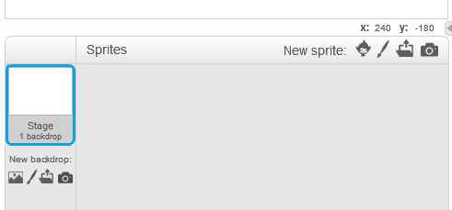
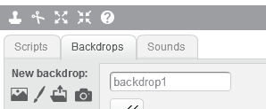
Prepare the Backdrop
Click on the Stage to make sure it is selected. Click on backdrops tab to edit the backdrop.

Slide 5
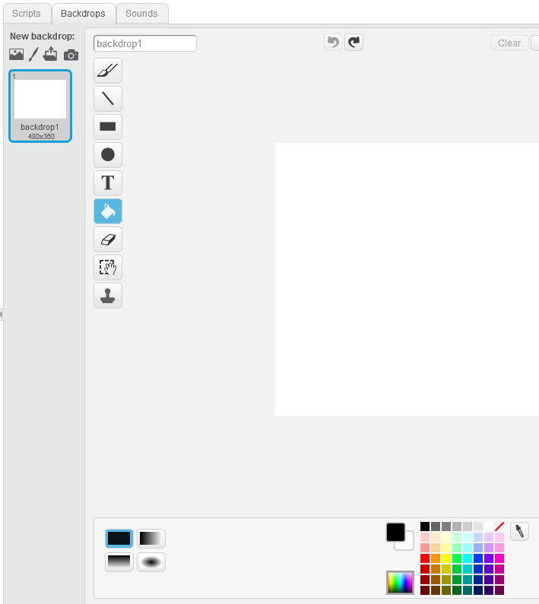
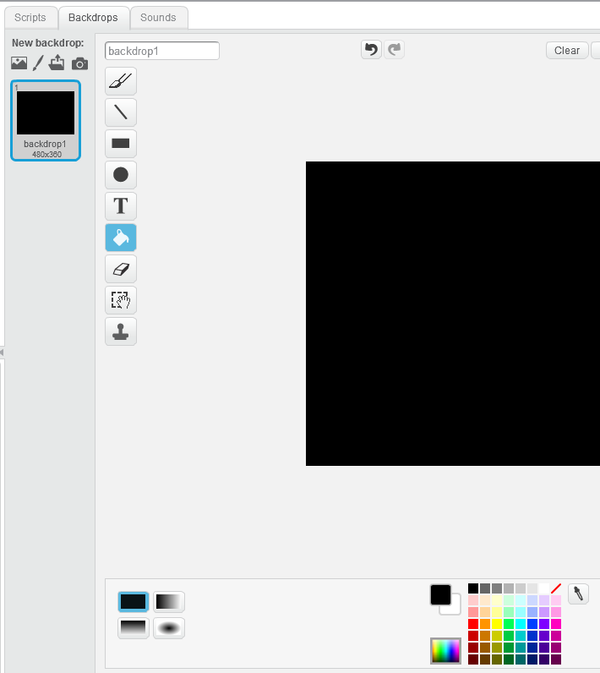
Let’s turn the background black

Slide 6

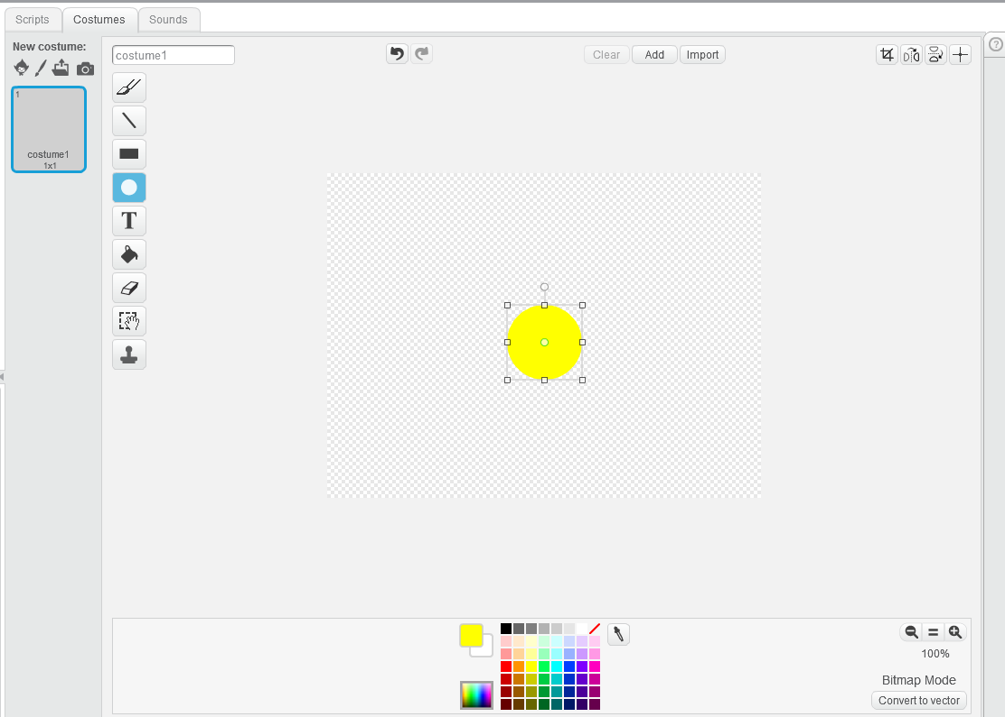
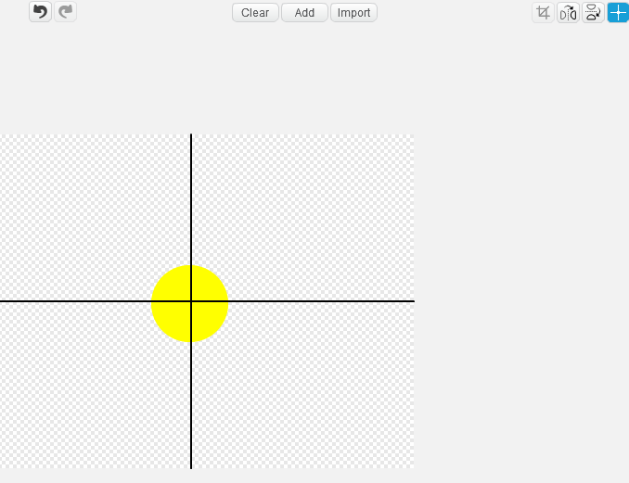
Let’s draw our PacMan sprite
Click on the paintbrush to draw a new sprite, choose the circle tool and hold shift while you drag out a circle to make sure it’s perfect. Click on the crosshairs tool then click on the center of your circle to center it.

Slide 7
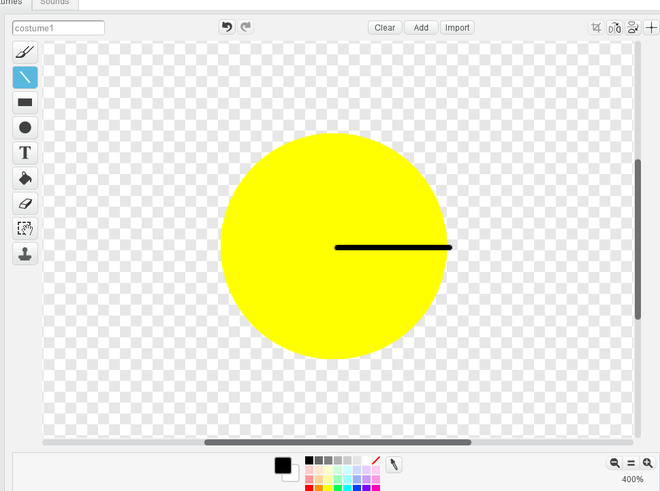

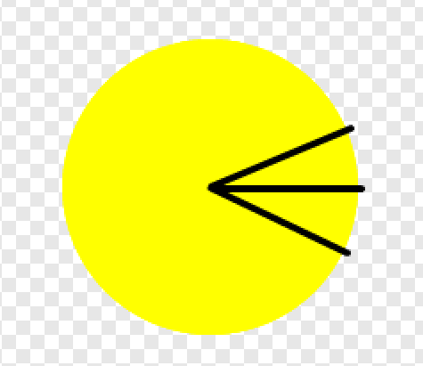
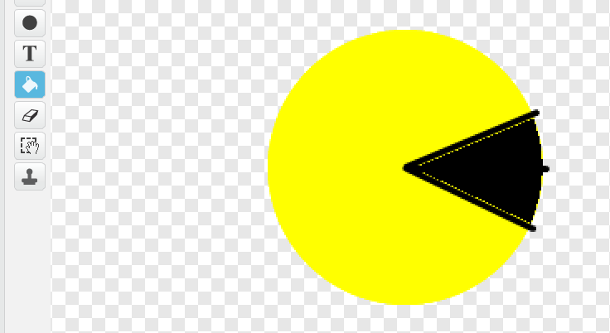
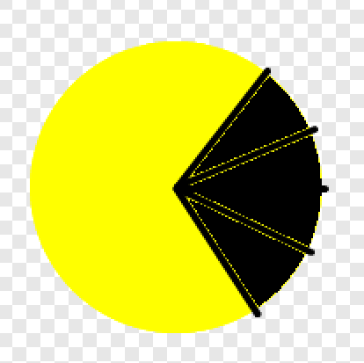
Details
Use the line tool to draw the closed mouth, right click and duplicate the costume and use the line tool and paint bucket to make a few more costumes like so.

Slide 8
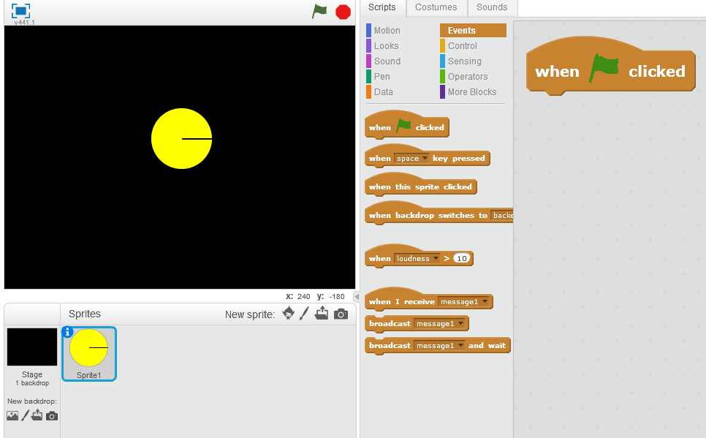
Add the scripts for PacMan
We start with the “when flag clicked” block to begin our game (drag the block from the events menu into the workspace)

Slide 9
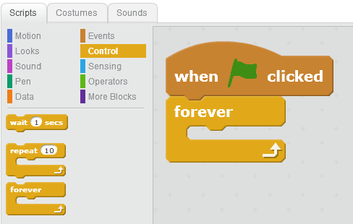
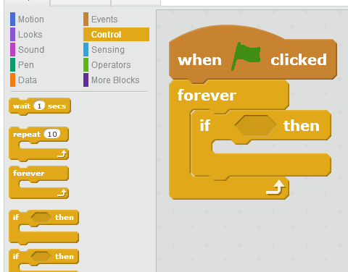
Smooth Movement
We can use some blocks from the Control menu to tell the computer to constantly check if the arrow keys are being pressed. If they are, then we will have PacMan respond appropriately by pointing in the correct direction, cycling through his costumes and moving however many steps we program.

Slide 10
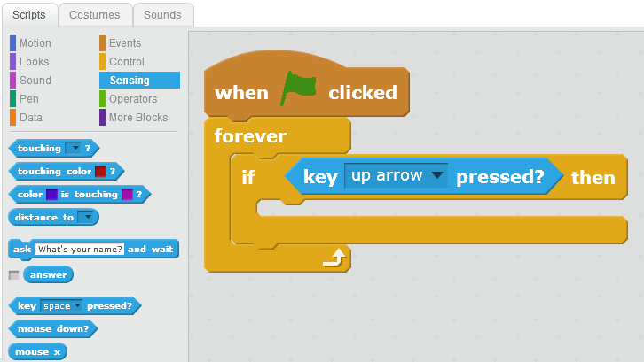
Note that only blocks with certain shapes will fit in some of the sockets.

Slide 11
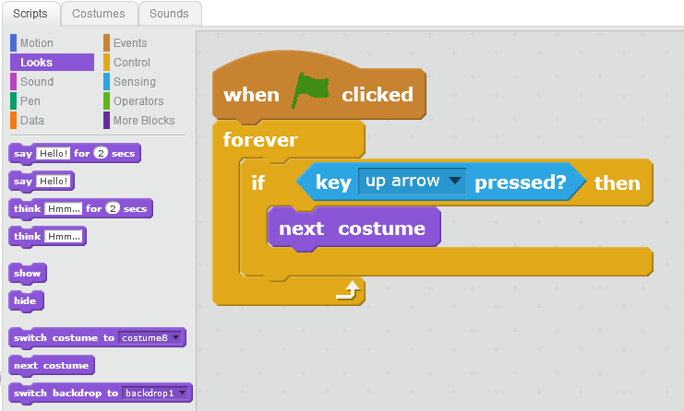
Animation
Having a sprite cycle through its costumes will give the appearance of animation.

Slide 12
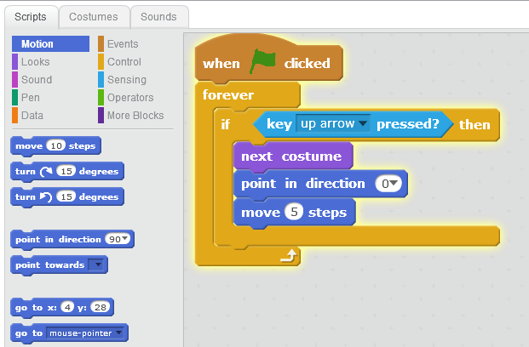
Motion
Note that you can drop down the direction to the preprogrammed ↑,↓,→,← or you can enter values or operators.

Slide 13
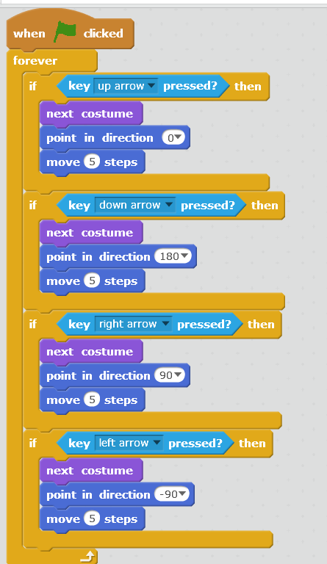
Duplicate and Modify
Right click on the “if-then” block and duplicate it, then do it again so you have all four directions covered. Change the keys and the directions and test it out, debugging where necessary.
You now have four conditional statements nested within a forever loop.

Slide 14
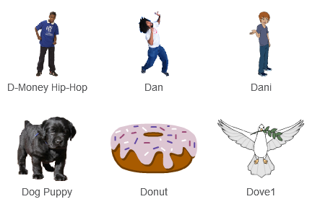
Let’s make an objective for our game
To make it simple, we will choose a new sprite from the library.
Double click on the Donut sprite to add it to our game. PacMan doesn’t always eat donuts, but when he does, he prefers ones with sprinkles.

Slide 15
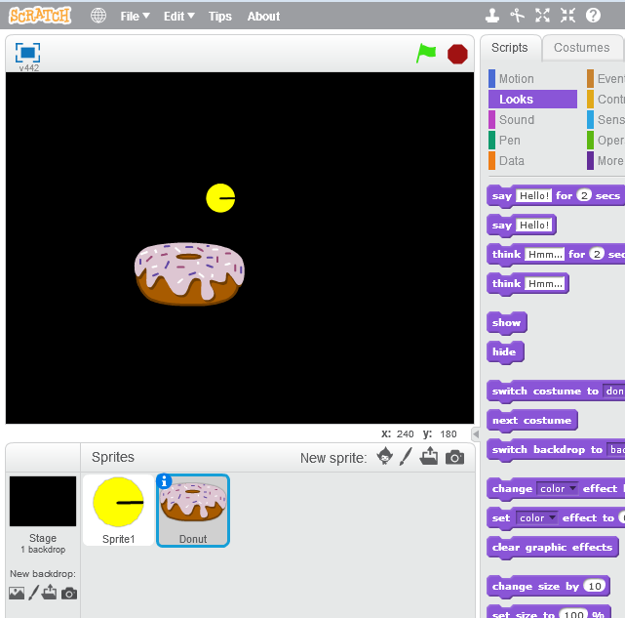
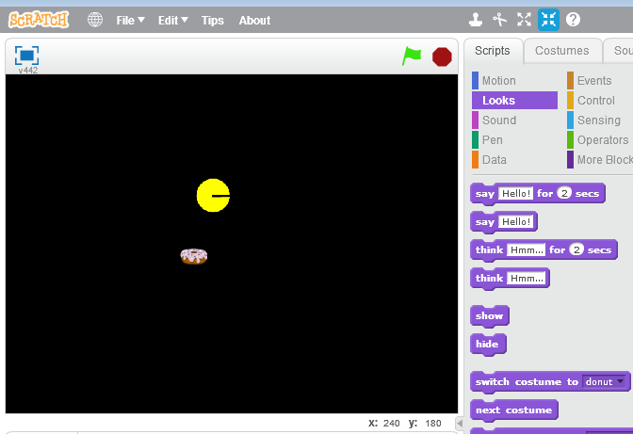
Shrinking Sprites
You’ll notice that the donut is much larger than PacMan. Use the shrink tool to make it more appropriate. Select the tool and then click on the donut until it looks good. You can do the same to PacMan if you like.
You can also make sprites bigger by choosing the grow tool.

Slide 16
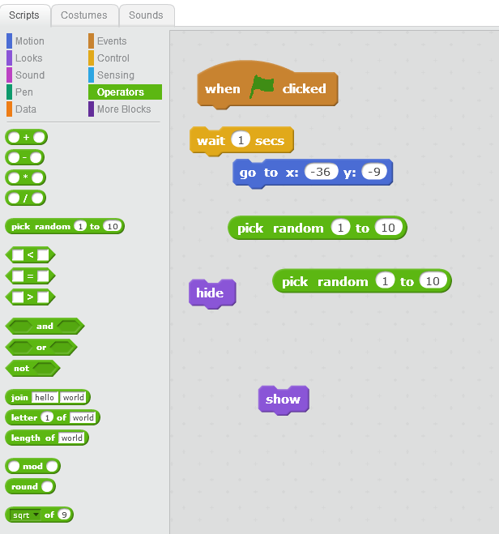
Scripts for the donut
We’ll have the donut begin the game hidden, then it will wait 1 second, go to a random spot on the stage and show itself. PacMan’s objective will be to find the donut and chomp it up.
See if you can arrange the blocks to make this happen. (Hover your mouse around the stage to get the min and max x and y values to plug into the “pick random” blocks)

Slide 17
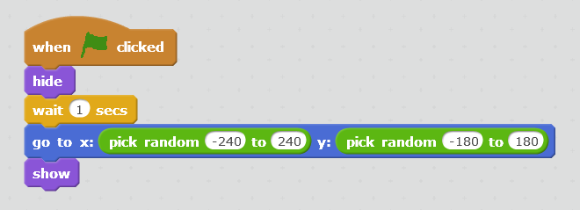
Scripts for the donut
That should be good for now, you can click the flag a few times to make sure you are getting some nice randomness.
Next we’ll want to create the code that allows PacMan to eat the donut and score a point.

Slide 18
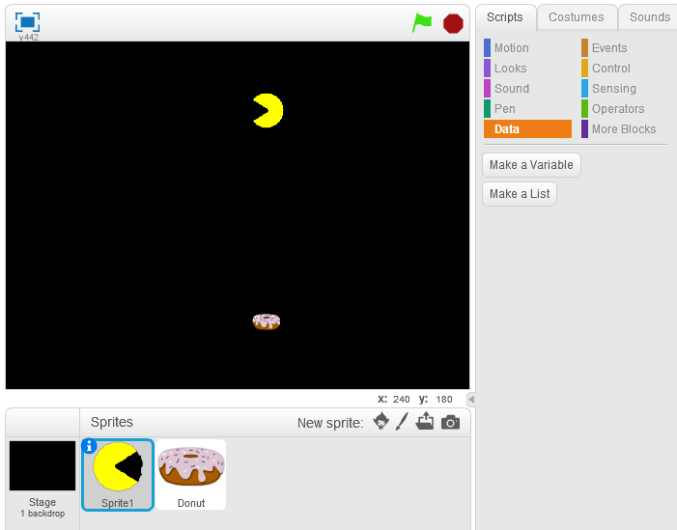
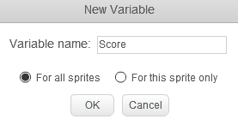
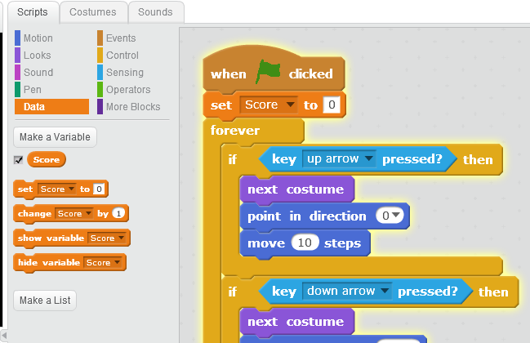
Add a variable
Click “Make a variable” from the orange Data menu. We’ll call it “Score” and make t for all sprites.
Select your PacMan sprite and set the score to zero after the flag is clicked.

Slide 19
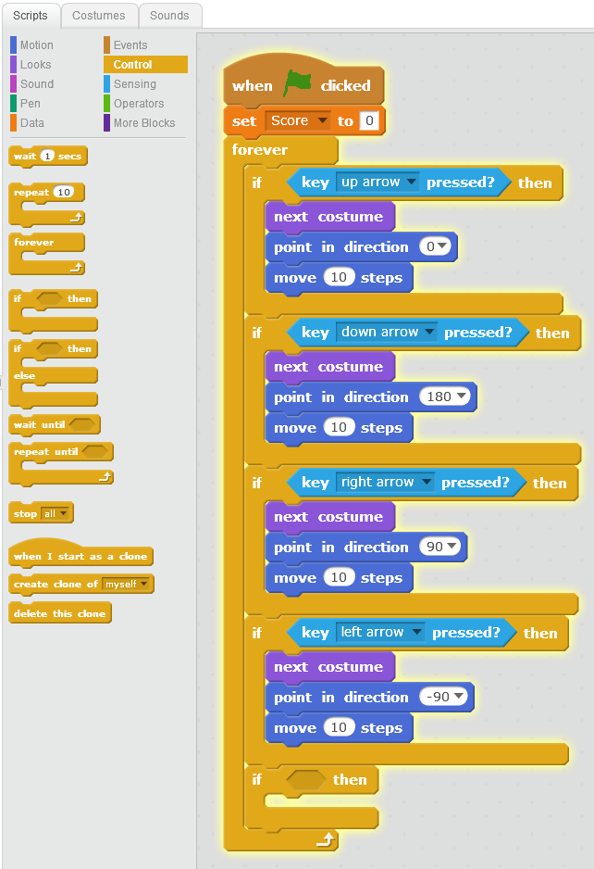
Broadcasting
We need to make a few things happen if PacMan ever touches the donut. Drag an if-then block out of the control menu and place it under the motion controls in his scripts.

Slide 20
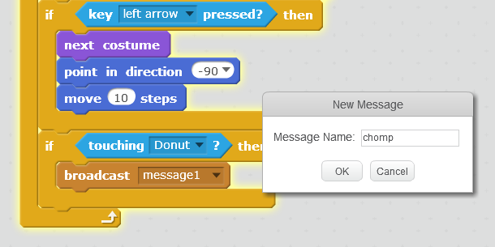
Broadcasting
Set it up like this, grabbing the “touching?” block from the light blue sensing menu and the “broadcast message” block from the brown Events menu.
Broadcast a new message called “chomp”
This is a handy thing to use if you ever need one sprite to communicate with another.

Slide 21
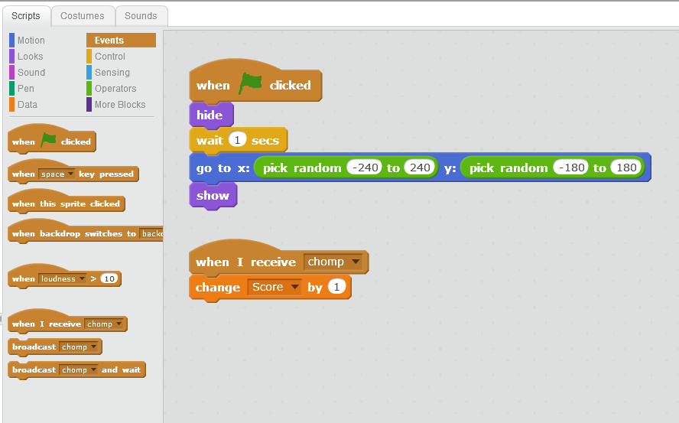
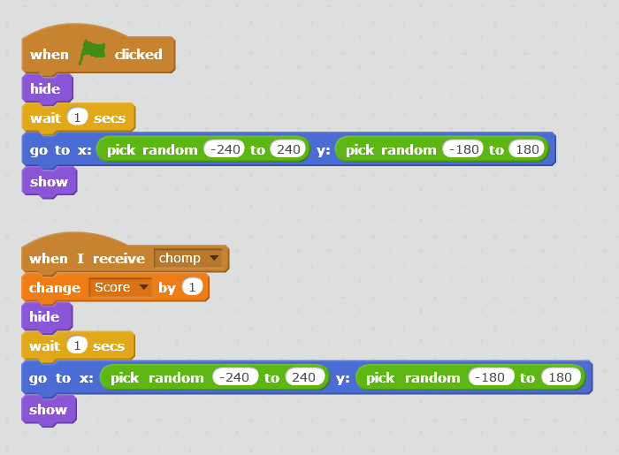
Broadcasting
Click on the donut sprite and grab the “when I receive chomp” block from the brown Events menu. Add the script to change the score from the orange Data menu and then right click on the “hide” script at the top and duplicate everything below it to add under the “change score” block.

Slide 22
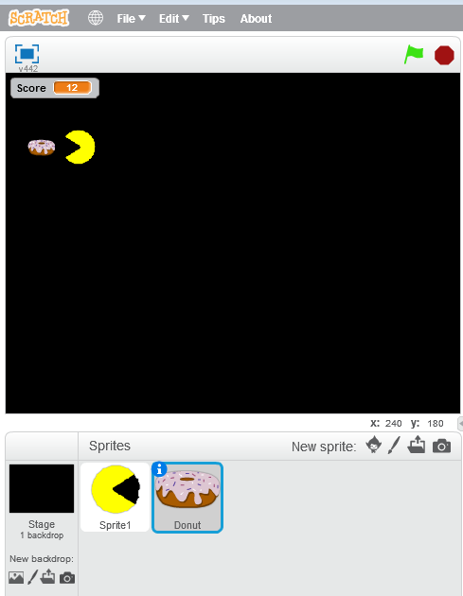
End of part 1
You should now have a game with a custom PacMan sprite, smooth movement, some nice random elements and a variable that tracks when two sprites interact and reports a value.
Try adding your own customizations - make PacMan start at the origin and face to the right, change the speed he moves, add a sound effect when he gets the donut, etc.
In part 2, we will add an antagonist, change levels, and track if the game has been won or lost.

Slide 23
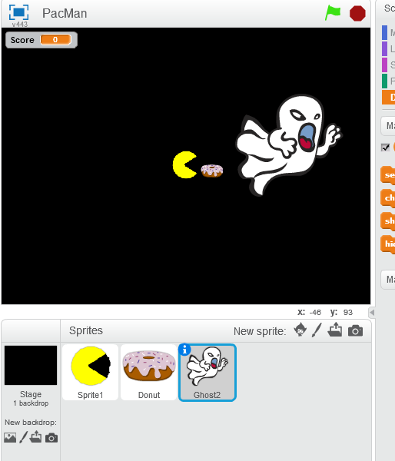
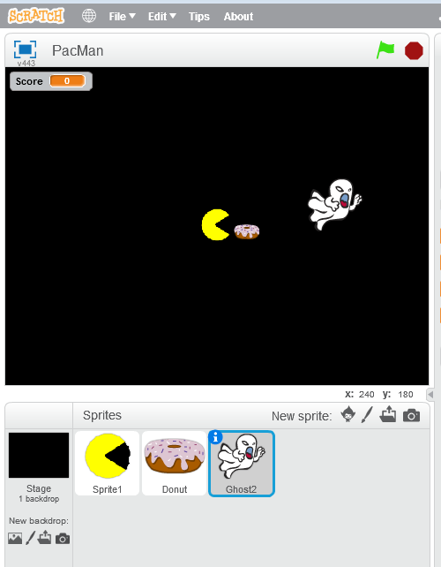
Part 2
Let’s add one of the Scratch ghosts to antagonize PacMan. Add the Sprite from the library, choose the angrier looking one and shrink it down a bit with the shrink tool (inward-pointed arrows).

Slide 24
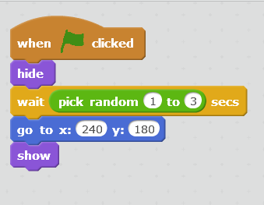
Add Scripts to the Ghost
Let’s tell the ghost to hide when the game starts, wait a random number of seconds, and appear in the top right corner. You should know where all the blocks are to make this happen, see if you can do it by yourself.

Slide 25
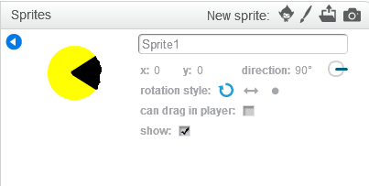
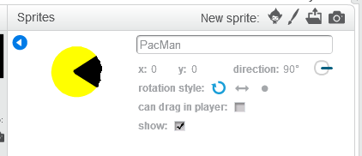
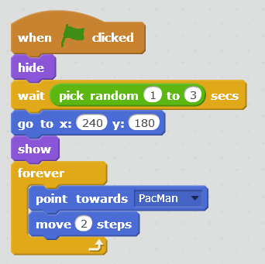
Add Scripts to the Ghost
Once the ghost appears, it should point toward PacMan and slowly move toward him. You’ll find the “point toward” block in the dark blue motion section - at this point we ought to rename Sprite1 as PacMan by clicking on the small “i” on the Sprite1 sprite. Now we can tell the ghost to FOREVER point towards PacMac and move 2 steps.

Slide 26
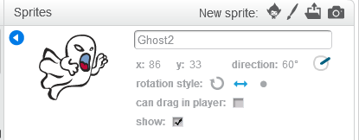
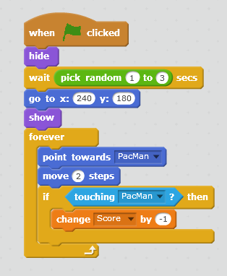
Change Rotation Style
You’ll notice if you run the program that the ghost is sometimes upside down. We can fix that by clicking on its “i” in the sprite area and changing its rotation style to “left-right” (there’s also a block that does the same thing in the motion menu).
Let’s have the ghost take away a point if it touches PacMan.

Slide 27
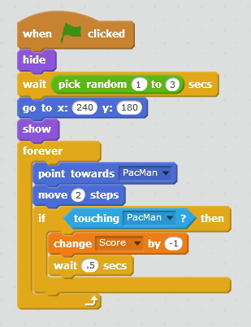
Debugging
As you run the game, something funny happens if the ghost touches PacMan...he rapidly loses points as long as he is in contact with the ghost sprite.
We can fix that by telling the ghost to wait half a second after changing the score.

Slide 28
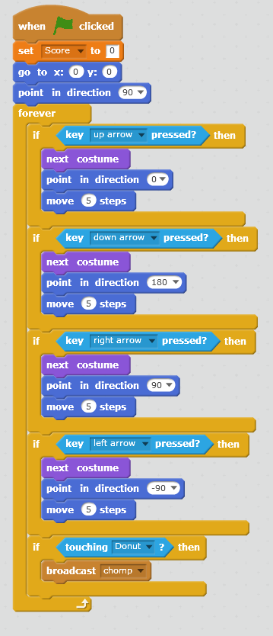
More motions for PacMan
Click on PacMan in the sprite area and choose the “go to x y” and “point in direction” blocks. We want pacman to start the game in the center of the screen and face to the right.
Remember that Scratch is laid out as a Cartesian Plane, meaning that the program keeps track of x and y positions for each sprite. The center of the screen is the origin (0,0) and the maximum and minimum values for x and y are 240, -240, 180, -180 respectively.

Slide 29
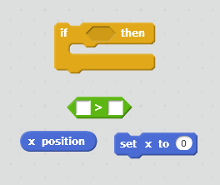
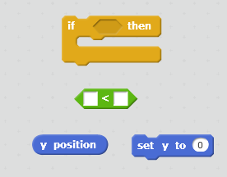
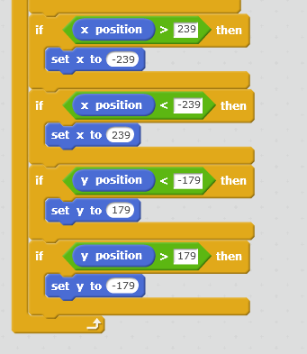
More motions for PacMan
Let’s use that information to allow PacMan to evade the ghost by going off one side of the stage and appearing on the other. We’ll set this up with the following conditional statement: If PacMan’s x position is ever greater than, 239, set it to -239. If it’s ever less than -239, set it to 239.
See if you can do it for his y position as well. You’ll need a total of 4 statements.

Slide 30
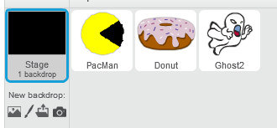
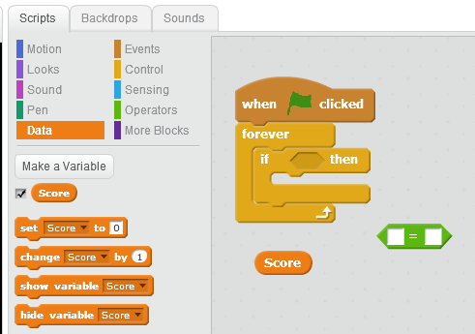
Changing Levels
Let’s add another level to our game. Most games get progressively harder, so our second level will introduce another, speedier ghost. Let’s start by triggering level 2 when PacMan gets his 5th donut. We’ll add these scripts to the Stage. We basically want the stage to constantly check PacMan’s score and broadcast a message when it equals 5.

Slide 31
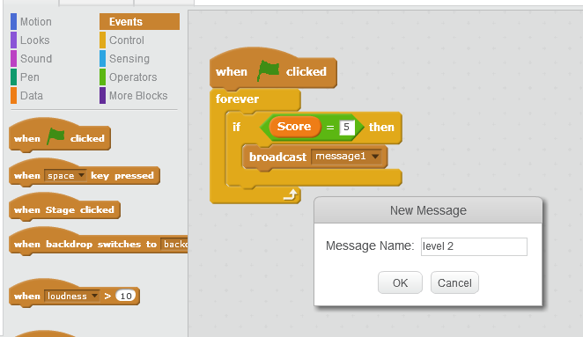
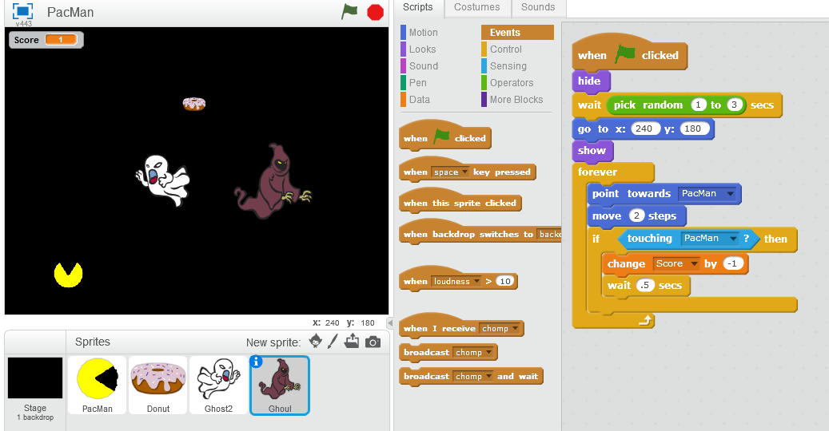
Broadcast “Level 2”
Now that our game is checking the score and broadcasting “level2”, we need to create a new sprite that will enter the game when it receives that message. Choose the ghoul from the library and copy all the scripts from the ghost by dragging them (from the when flag clicked block) and dropping them on the ghoul.

Slide 32
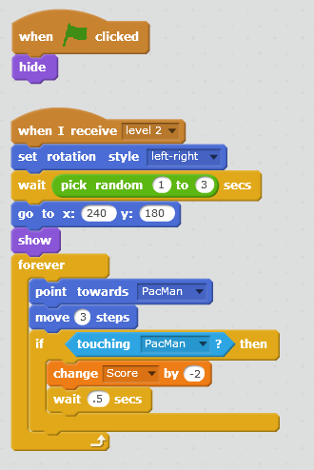
Receiving the message
The only thing we need to change is the “hat block” that triggers the ghoul. When the flag is clicked we want it to hide and when it received the message “level 2” we want it to show.
You can change its speed, make it go to a random place when it appears, or whatever else you think would make the level more challenging.

Slide 33

Ending the Game
To wrap this up, let’s say that the game ends when PacMan gets his 10th point. We can accomplish this the same way we did the levels, by adding a script to the stage that checks the score and broadcasts a “You Win” message. While we’re at it, let’s also end the game if PacMan’s score is ever less than 0.

Slide 34

“You Win” and “Game Over” Sprites
Choose Paint New Sprite from the sprite area and use the text tool to write You Win. Do the same thing again but this time type Game Over.
I did mine in vector mode using the Scratch fontThe code for each will be very similar so we’ll do one and then copy it to the other by dragging and dropping it onto the sprite.

Slide 35


Ending the game
This is a very basic way to end the game. You can add some animation to the words by playing around with the different effects in the purple looks menu, but I think this will suffice for now.

